Slide 1
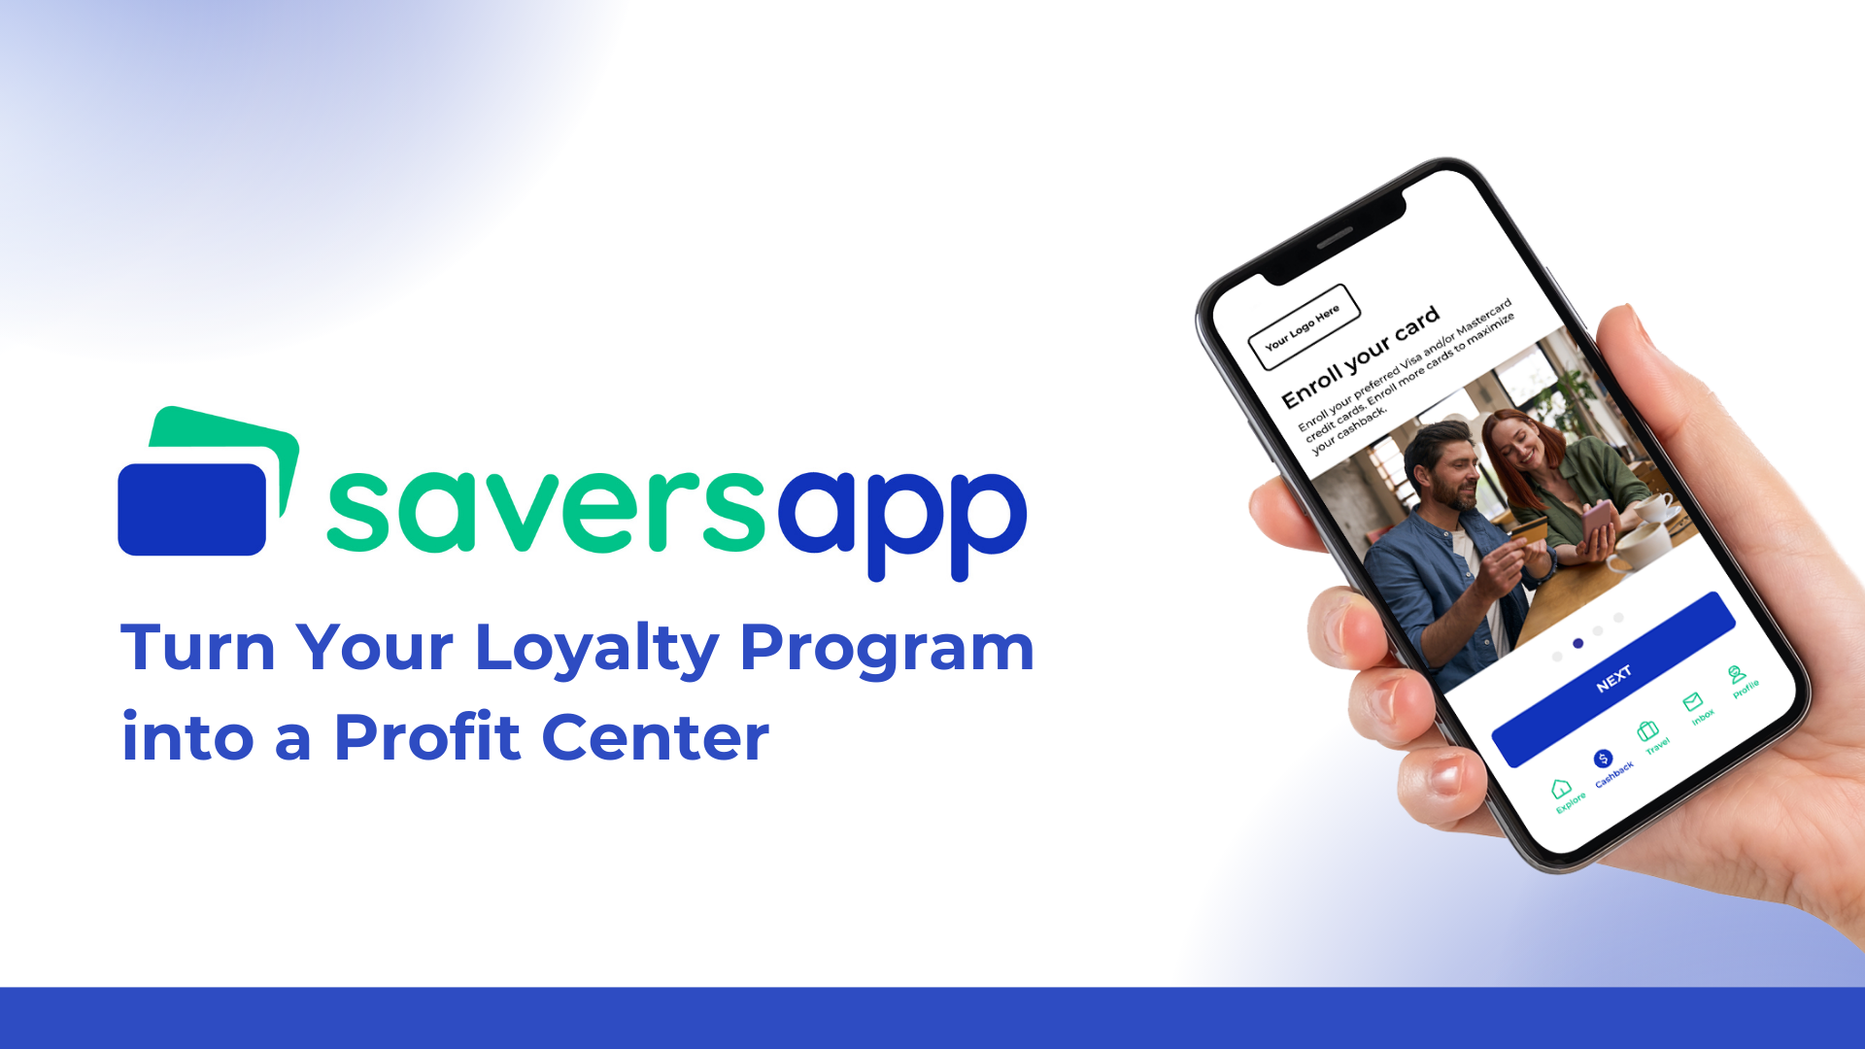
Notes:
Welcome to Savers App, a truly unique loyalty cashback program with significant income potential. Our programs outperform most Fortune 500 companies' loyalty programs and are designed not only for large corporations but also for mid-sized businesses. As I will demonstrate during this presentation, the opportunities are unmatched.

Slide 2
Notes:
But first, a bit about us:
Founded in 2003, we bring over 21 years of experience in the cashback industry. We are a U.S.-based company with our headquarters in Salt Lake City, Utah. In addition to our U.S. operations, we also have a global presence with our main office located in Dubai, UAE, and a software development hub in Bangalore, India.
Over the past 21 years, we have primarily developed and managed cashback programs for large enterprises on a global scale, including banks, telecom companies, retail chains, and more.

Slide 3
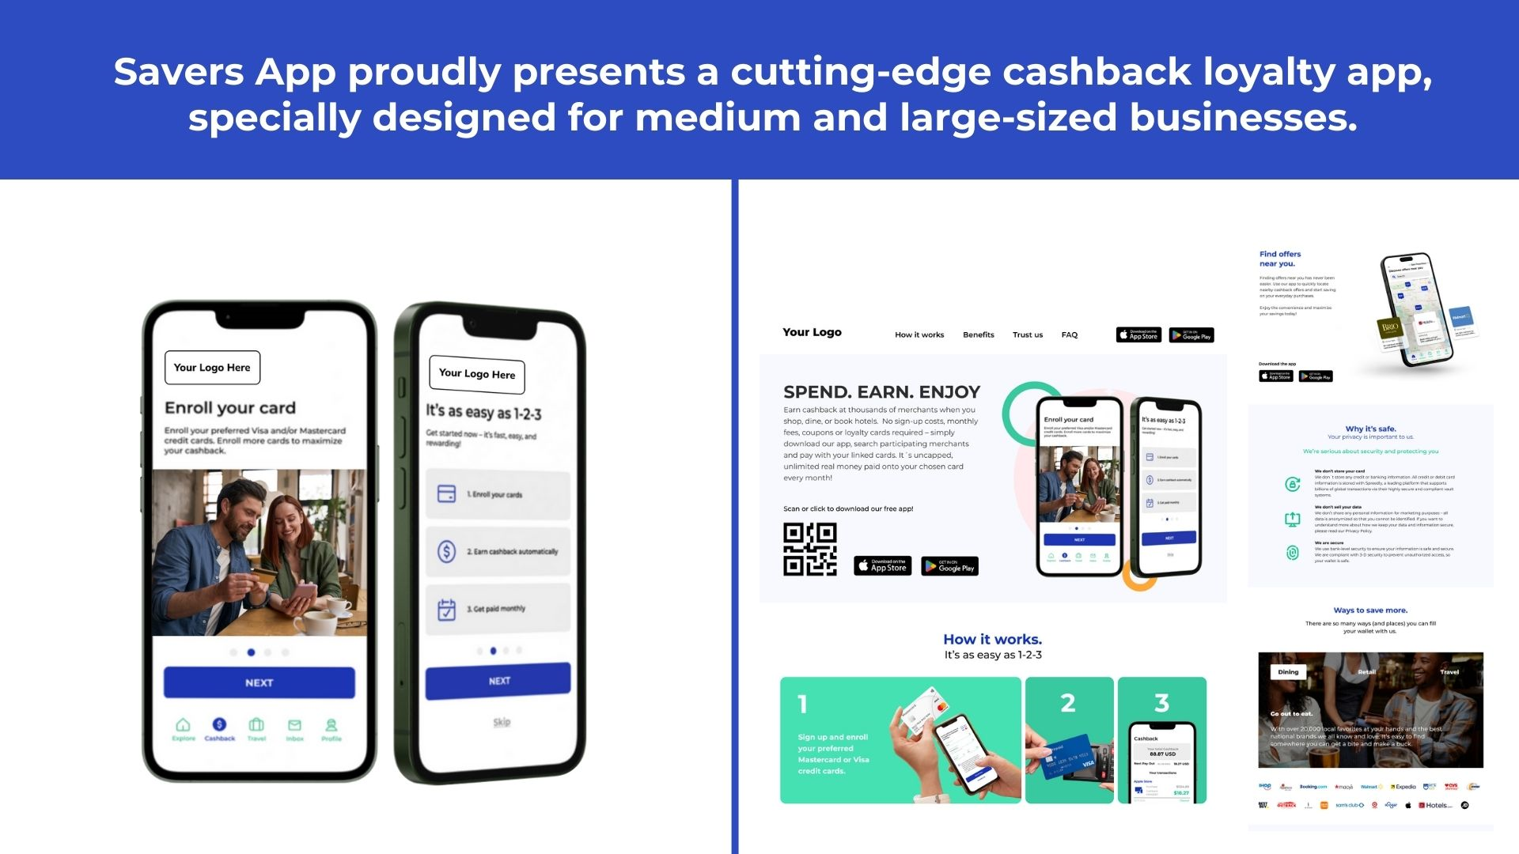
Notes:
With our new brand, Savers App, we provide both large enterprises and medium-sized businesses with a custom, top-tier cashback loyalty program tailored to your unique needs. We offer a co-branded cashback app that allows your customers to shop seamlessly, along with a co-branded website that clearly showcases the benefits of downloading your app and joining your loyalty program.

Slide 4
Notes:
As something entirely new and groundbreaking, our app is built around a technology called card linking. This makes it extremely user-friendly for your customers and works as follows: Customers download your app and securely enroll their credit and debit cards—we support both Mastercard and Visa. They then designate a preferred card to receive their cashback from all linked cards, with payouts transferred automatically each month.

Slide 5
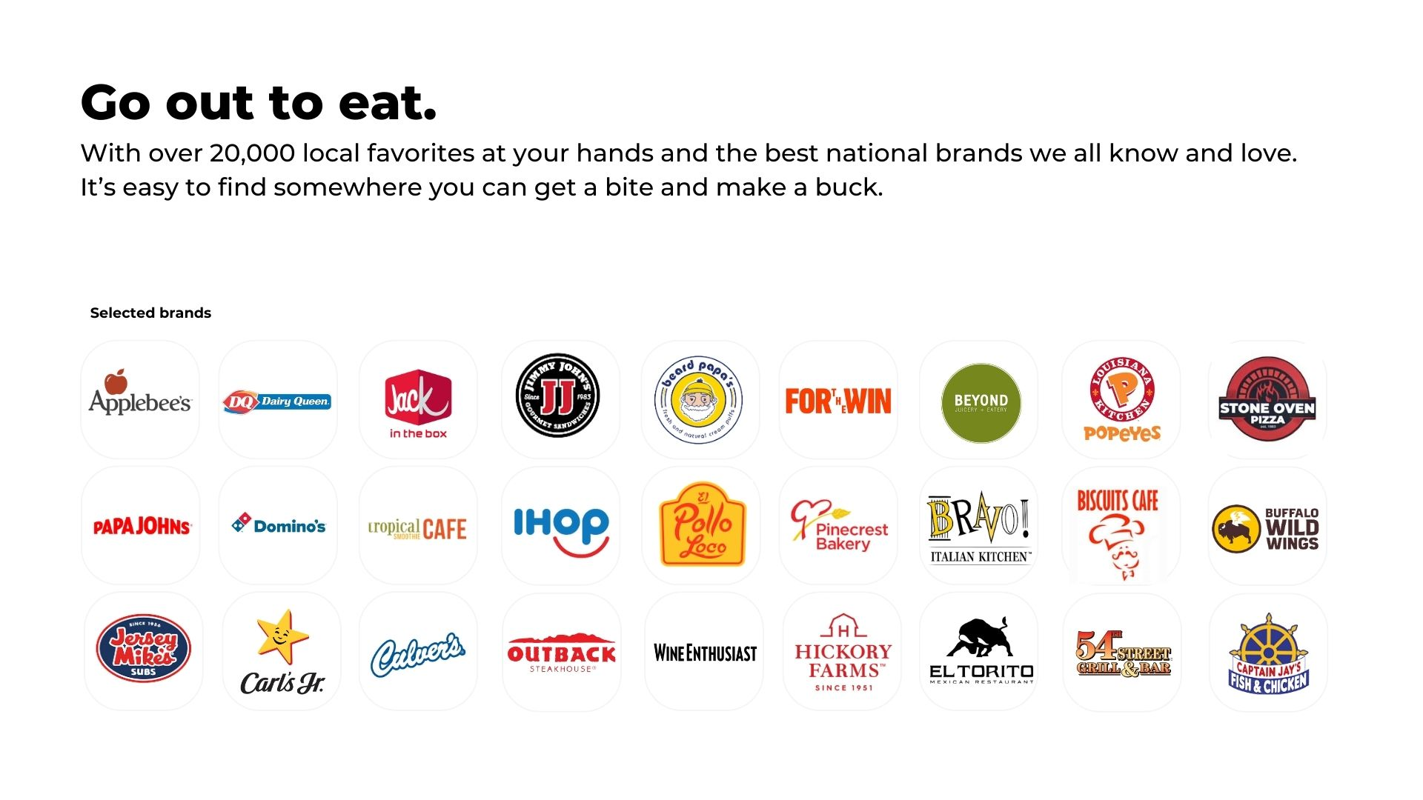
Notes:
Your customers now have the opportunity to earn 5% cashback when dining out at over 20,000 US restaurants. When they pay with one of their enrolled credit cards, they will automatically receive a push notification showing how much cashback they've earned—it's that simple. They also have the opportunity to search for nearby restaurants through the app to ensure they earn their 5% cashback.

Slide 6
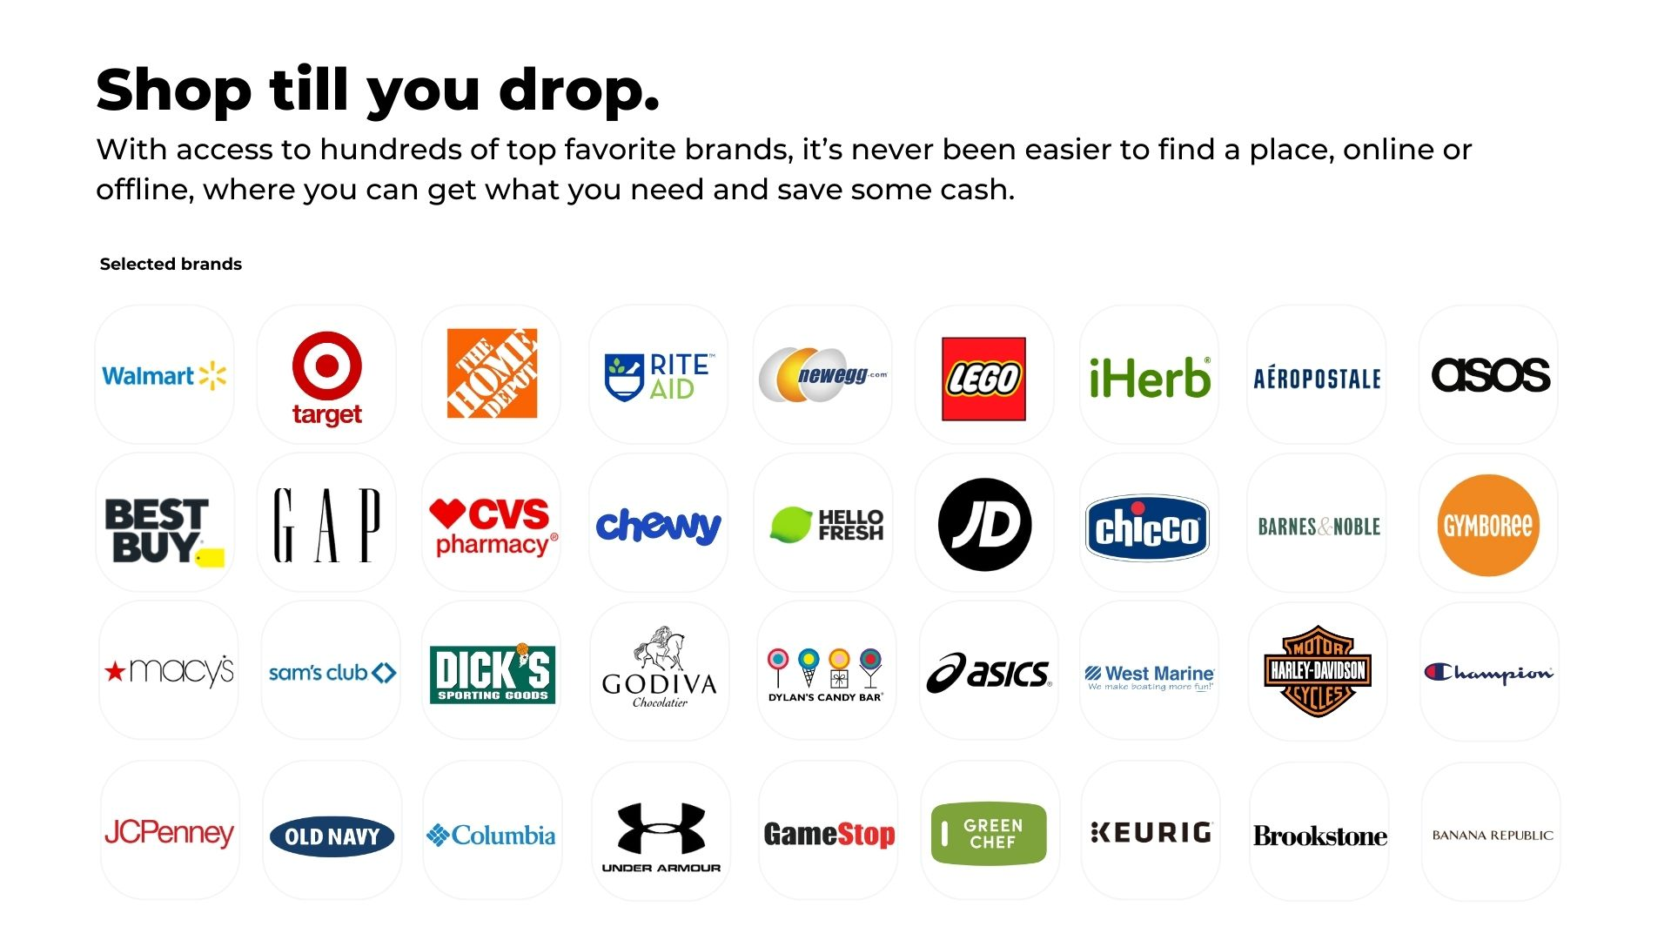
Notes:
Customers also gain access to cashback at hundreds of leading online retailers. In most cases, they simply pay with one of their enrolled cards to receive their rewards. For select retailers, customers may need to click through the app to complete their purchase and earn cashback. Additionally, we partner with physical retail stores and plan to expand these offerings even further in 2025.

Slide 7
Notes:
The Savers App goes above and beyond by offering cashback on luxury brands—something rarely available with discounts. Here’s a selection of some premium brands your customers can enjoy.

Slide 8
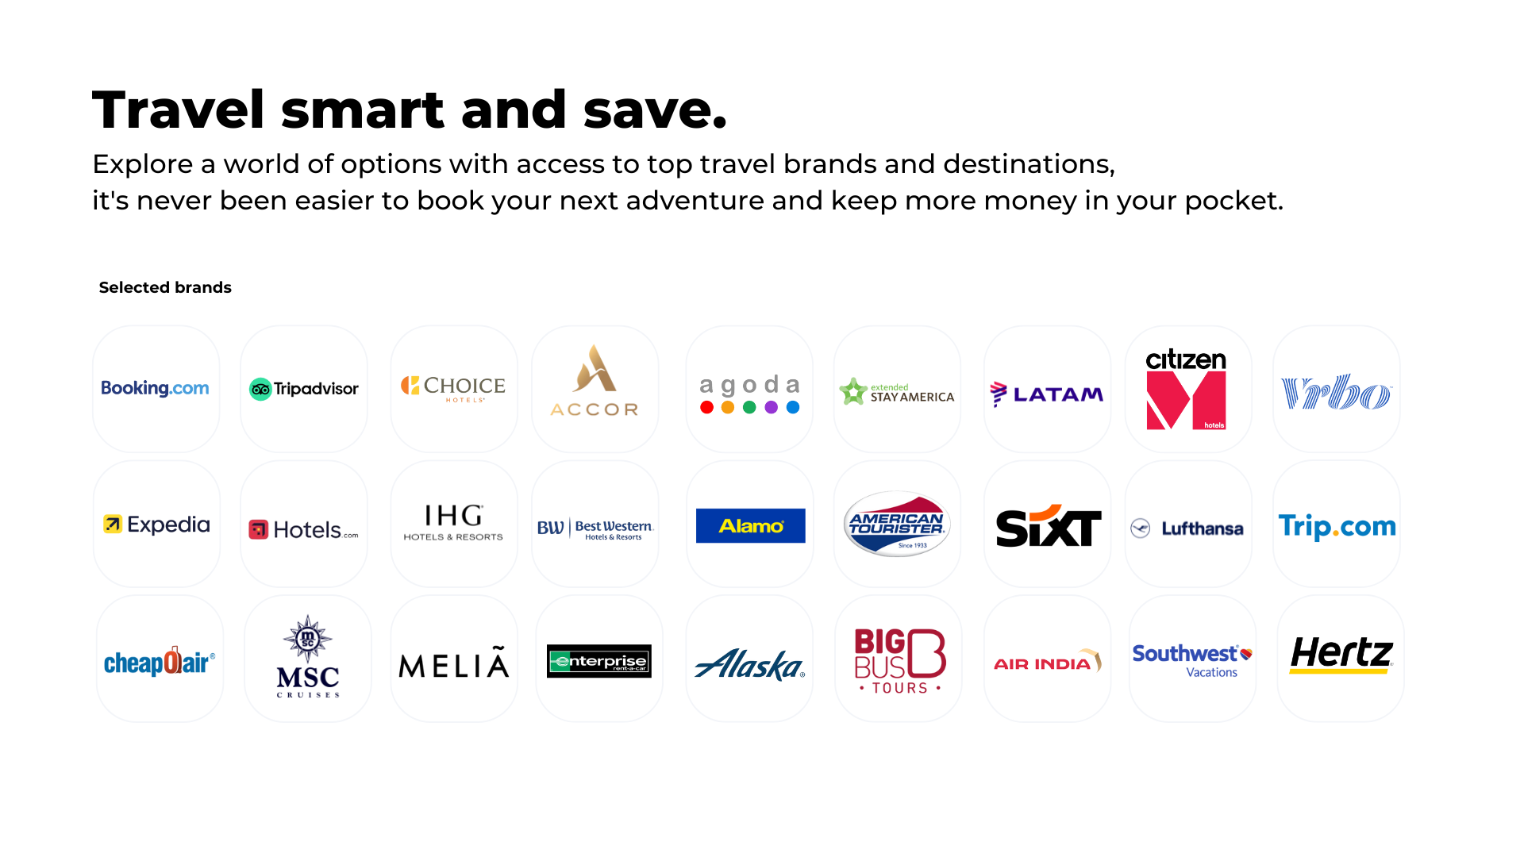
Notes:
We also offer your customers cashback on most major travel brands. As you may know, travel is a massive market, accounting for one-third of all online spending. In the U.S. alone, travel spending is projected to reach $1.2 trillion in 2025.

Slide 9
Notes:
We offer your customers an extraordinary opportunity to access over 850,000 hotels, theme parks, and car rentals worldwide, including more than 180,000 destinations in the U.S. Through our exclusive members-only travel portal, they can enjoy up to 50% cashback on the best available starting prices.

Slide 10
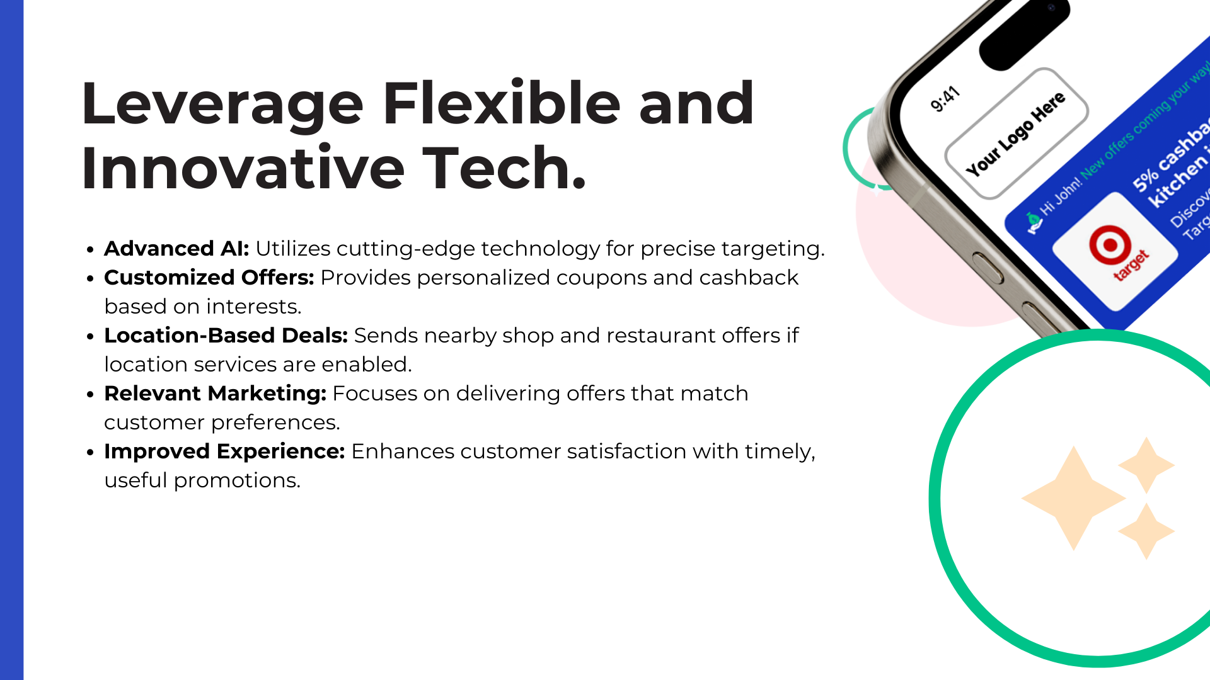
Notes:
Our app is built on the latest AI technology, enabling us to send your customers relevant offers that we know in advance they will be interested in. This is truly a key to success, as your customers experience it as an added service rather than annoying, irrelevant ads. This helps keep them engaged with the app and fosters appreciation for your brand.

Slide 11
Notes:
Your app includes a built-in customer referral program, designed to leverage the power of word-of-mouth. This feature enables you to expand your customer base effortlessly and cost-effectively, while helping new customers discover how to earn cashback on their everyday purchases.

Slide 12
Notes:
Your customers will receive newsletters and push notifications from you, each of the highest quality, featuring attractive cashback offers and valuable tips on how to use the app in their daily lives to achieve the best savings. On a daily basis, they will be reminded of your brand, continually associating it with excellence.

Slide 13
Notes:
Unlike other loyalty programs, Savers App actually provides you with a significant opportunity to generate substantial income. We offer a commission of 10% of the total cashback earned by your customers, paid directly back to you.
Here are three examples of what this can amount to:
• In the first example, let's assume 1,000 customers each upload 2 cards to the app. While Experian reports that the average family has 4 to 6 cards, we’ve taken a conservative approach and used 2 cards per customer. Then, if each card earns $100 cashback annually, this would result in a total of $200,000 in customer cashback. Your commission from us would be $20,000.
• With 10,000 customers, we would pay out $2 million on your behalf, and your commission would be $200,000.
• In the final example, with 100,000 customers, we would pay out $20 million on your behalf to your customers, and you would receive $2 million in commission from us, all for what I believe is a minimal effort on your part, as we handle the entire program for you.
This is a unique and lucrative opportunity, requiring very little involvement from your side, while generating substantial returns.

Slide 14
Notes:
With the Savers App program, you also gain access to your own world-class partner portal where you can track every aspect of your business. You’ll be able to view all your customers, see how many cards they’ve uploaded, track their spending, and monitor your earnings.
Additionally, you will have access to first-class marketing materials, which you can freely use to promote your program, along with a news section for relevant updates from us. You can assign different levels of personal access to your employees within the back office, ensuring they only see the information that is relevant to their role. And much more—everything you need to build and manage your program is right at your fingertips.

Slide 15
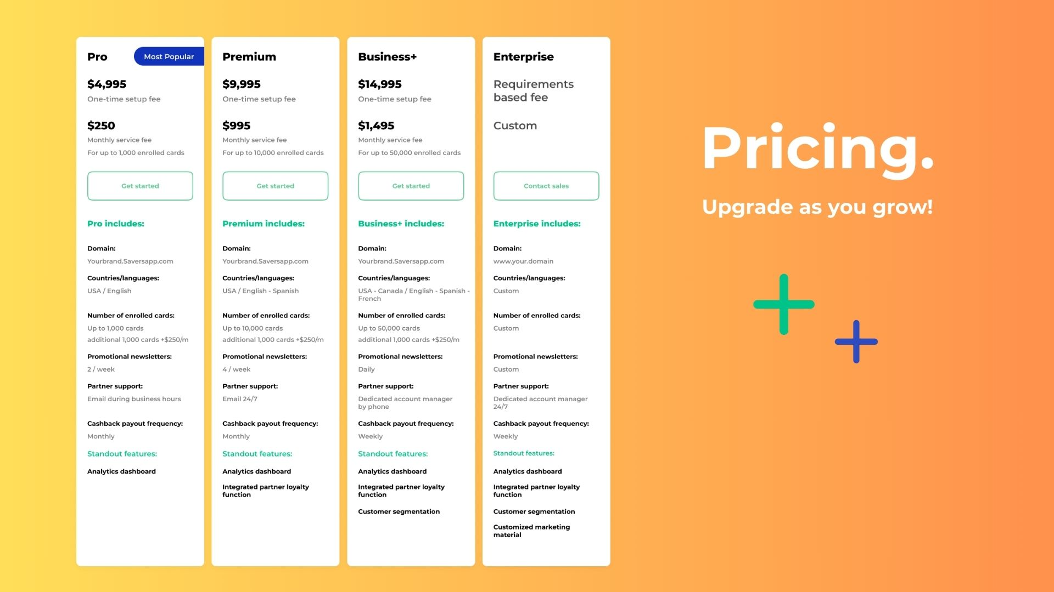
Notes:
We offer a variety of flexible startup packages for our program, with one common benefit: a single, one-time setup fee. Beyond that, there are no ongoing costs for managing your program, apart from a small fee paid directly to our trusted, top-tier banking partner for the uploaded cards in your program.
Our most popular package, the Pro package, is designed to give you incredible value, starting at just $4,995. After that, you’ll pay only $250 per month until you’ve uploaded 1,000 cards. Once you reach 1,000 cards, the monthly fee increases to $500, and this continues as you scale up to 2,000 cards, and beyond.
The best part? The more cards you upload, the greater the discount you can receive! Not only can you enjoy extra features with each package, but you'll benefit from lower ongoing costs per uploaded card as your program grows. And if you want to upgrade your package at any time, you’ll only pay the difference.
This is an incredibly cost-effective way to grow and manage your loyalty program while maximizing your potential savings and earnings.

Slide 16
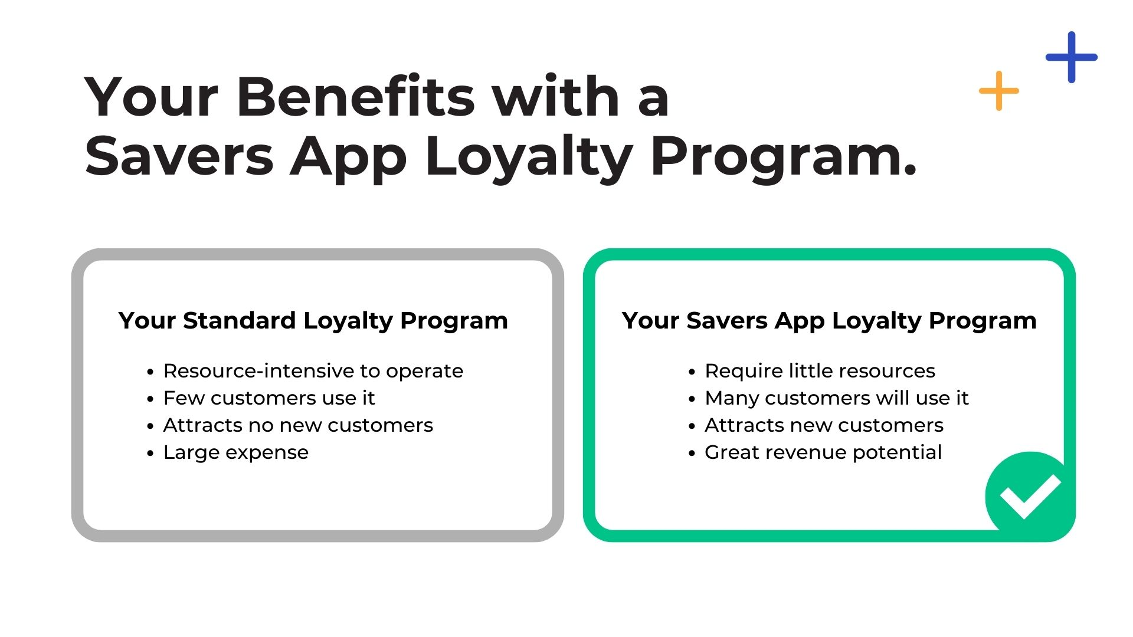
Notes:
Here’s a point-by-point comparison of your normal loyalty program versus your Savers App Loyalty Program:
1. Resource Efficiency
o Your Normal Loyalty Program: Resource-intensive to operate, requiring significant time, money, and effort to maintain.
o Your Savers App Loyalty Program: Requires minimal resources and more cost-effective.
2. Customer Engagement
o Your Normal Loyalty Program: Few customers actively use it, leading to low engagement and limited value.
o Your Savers App Loyalty Program: Many customers will use it, ensuring higher participation and stronger customer loyalty.
3. Customer Acquisition
o Your Normal Loyalty Program: Fails to attract new customers, offering little to no growth potential.
o Your Savers App Loyalty Program: Attracts new customers, helping to expand your customer base and grow your business.
4. Financial Impact
o Your Normal Loyalty Program: Represents a large expense with minimal return on investment.
o Your Savers App Loyalty Program: Offers great revenue potential, transforming your loyalty program from a cost center into a profit generator.
This comparison really highlights how the Savers App loyalty program outperforms traditional programs in efficiency, customer engagement, growth potential, and profitability.

Slide 17
Notes:
I want to emphasize that this is a partnership opportunity for both of us—your success is our success, and we’re committed to doing everything we can to support you. I recommend we head over to Saversapp.com, so I can show you how to get your program up and running as quickly as possible.

